Slide 1

Follow up for Providers

Slide 2
Purpose of Today’s Webinar
We will review and answer frequently asked questions
  Please write your question’s in the dialogue box of the webinar. They will be answered throughout the remainder of the presentation

Slide 3

Allegiance and Disney–FAQ’s
Ancillary Networks
Cigna recently sent out a notice to the ancillary providers explaining the process.
The following Ancillary providers were contacted:
ASHN – Chiropratic/PT/OT
CareCentrix – DME/HomeHealth
Quest/Lab Corp
Evicore – High tech radiology
Cigna national dialysis providers

Slide 4
Allegiance and Disney–FAQ’s
Authorizations with Cigna
Approved authorizations completed with Cigna have been transferred to Allegiance and will be honored.
Evicore authorizations approved last year will need to be re-submitted as the Allegiance system does not recognize the old ID #. Please request they be moved to the new plan/correct ID#.

Slide 5
Allegiance and Disney–FAQ’s
Specialist Referrals
  Providers should refer to other providers contracted with Orlando Health.
  There is no benefit for non-emergent services rendered outside the Orlando Health service area.
Contact the Orlando Health Concierge line to verify providers are in network.
1-844-939-6437

Slide 6
Allegiance and Disney–FAQ’s
Fee Schedules
Contracting
Credentialing
For more information, please contact:
Please use the r-valuecontracts@orlandohealth.com or the centralized department number of 321-843-6700.

Slide 7
Allegiance and Disney–FAQ’s
Verification of Benefits
Online Verification of Benefits is available at: www.askallegiance.com/disneyoh
Allegiance Customer Service is available from 8am-8pm EST, Monday through Friday at (855) 999-1522. An Automated Voice Response system (IVR) is also available 24/7/365 for claims and benefit information.
270/271, 276/277 Transactions Allegiance Payer ID: 81040

Slide 8

Allegiance and Disney–FAQ’s
Inpatient Certification
These services will be coordinated through StarPoint Health Group, an Allegiance company. StarPoint’s Nurse case managers and reviewers are available 9am-7pm EST, by phone at (800) 342-6510

Slide 9
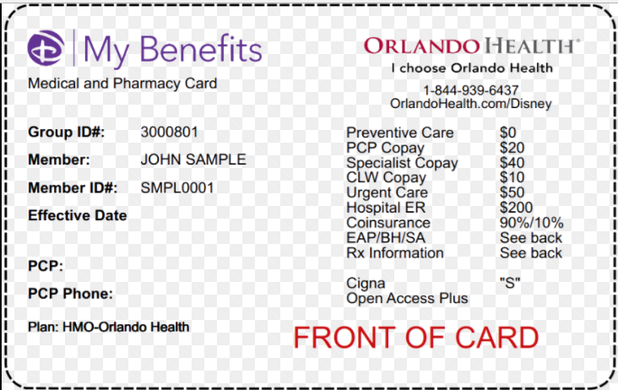
Allegiance and Disney–FAQ’s
Sample ID Card (front)

Slide 10
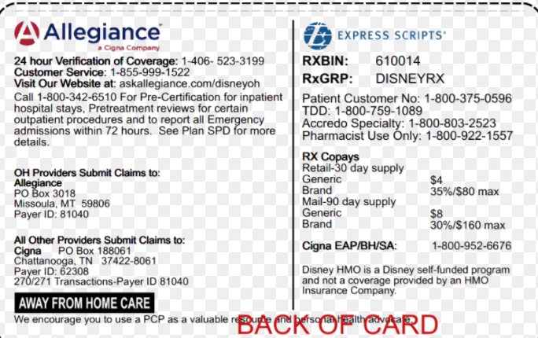
Allegiance and Disney–FAQ’s
Sample ID Card (back)

Slide 11
Allegiance and Disney–FAQ’s
Allegiance Customer Service
    Allegiance Customer Service can be reached Monday through Friday, 8am-8pm EST.
      (855)-999-1522
    Call volumes have decreased since the first of the year. Hold times have decreased while our average speed of answer has increased. Allegiance systems have been programmed to offer a voicemail option if you do not wish to wait on hold longer than 2 minutes.

Slide 12
Allegiance and Disney–FAQ’s
Provider Webinar
Information for providers can be found on our website.
www.askallegiance.com/disneyoh
Click on the “For Providers Only” link on the bottom right hand corner of the landing page.

Slide 13
Allegiance and Disney–FAQ’s
QUESTIONS?

Slide 14
Allegiance and Disney–FAQ’s
Thank you for joining today!

